Slide 1
What is a bumblebee?

Slide 2
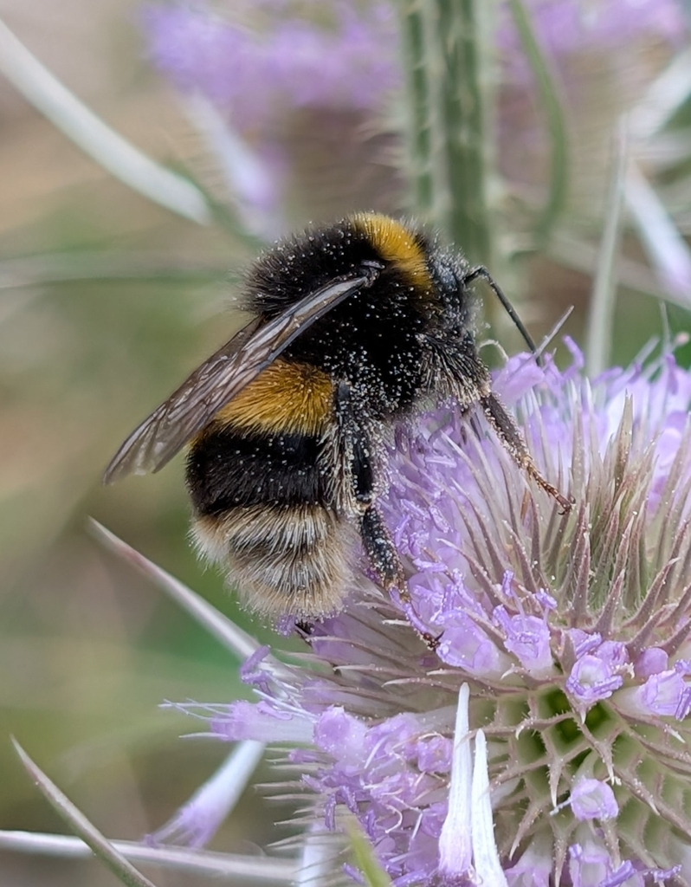
Learning outcomes
I can describe some differences between bumblebees and other insects.
I can use observations to identify if an animal is bumblebee.
Buff-tailed bumblebee

Slide 3
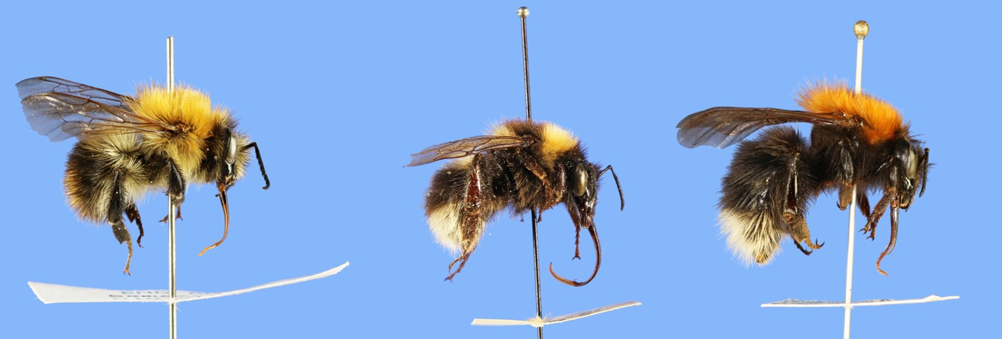
Here are three bumblebees from the Natural History Museum
How many differences can you spot?
This is their tongue!
Notes:
Other starter question options:
How many differences can you spot?
Which one would be the best as a friend?
Which one is your favourite?
This is to get learners into the habit of looking for details. At this stage, similarities can be anything.
Explanations for other questions should refer to features learners observe in the bumblebees.

Slide 4
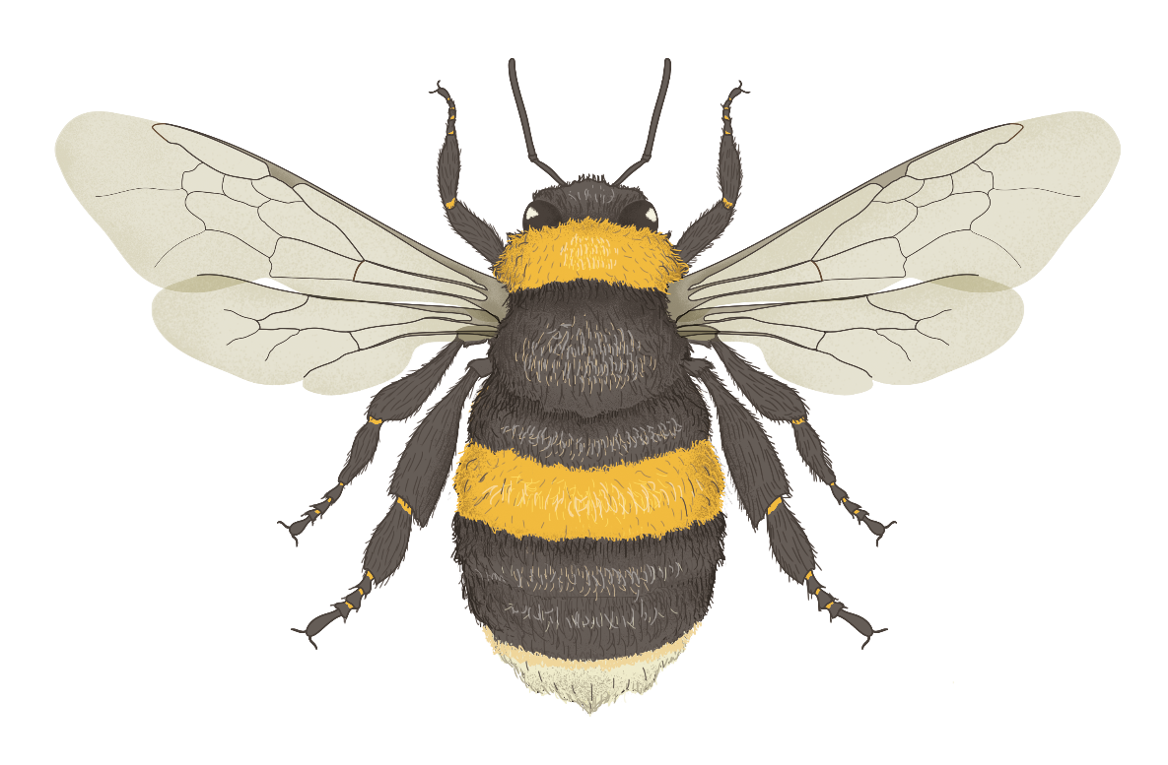
What is a bumblebee?
Forewings
Bumblebees are:
Insects
They have 6 legs and 3 main body parts.
Related to bees and wasps
They have 2 pairs of wings.
Head
Thorax
Abdomen
Hindwings
Notes:
Bumblebees are:
insects
They have 6 legs and 3 main body parts.
related to bees and wasps.
They have 2 pairs of wings. Bumblebee, bees, and wasps also have a narrow waist, but this is hard to see on bumblebees because of their fur
big with round bodies
Wasps and bees tend to have longer, thinner bodies.
Fuzzy all over
Helps separate bumblebees from many other insects, although many bees and some flies are also fuzzy.

Slide 5
What is a bumblebee?
Bumblebees are:
Big with round bodies.
Fuzzy all over
Notes:
Bumblebees are:
big with round bodies
Wasps and bees tend to have longer, thinner bodies.
Fuzzy all over
Helps separate bumblebees from many other insects, although many bees and some flies are also fuzzy.

Slide 6
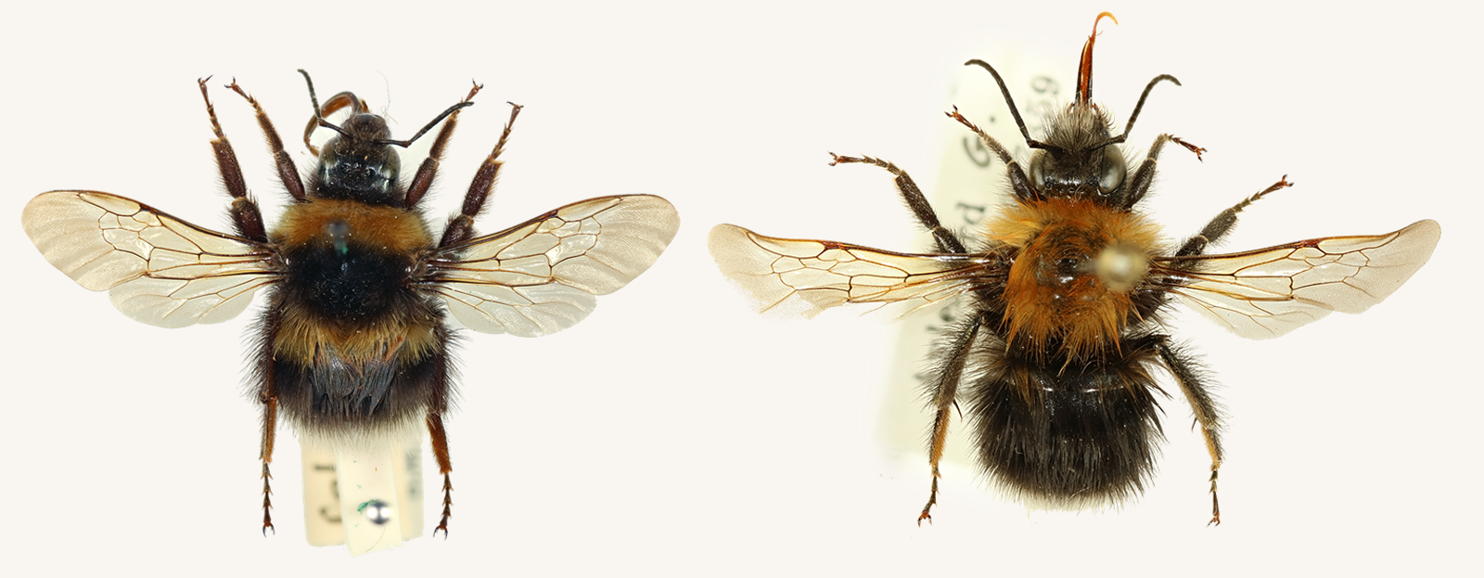
Here are two bumblebees from the Natural History Museum
How many similarities can you spot?
Word bank
Head
Thorax
Abdomen
Forewings
Hindwings
Antennae
Notes:
Learners should use words in the word bank to describe parts of the bumblebees using scientific vocabulary.

Slide 7
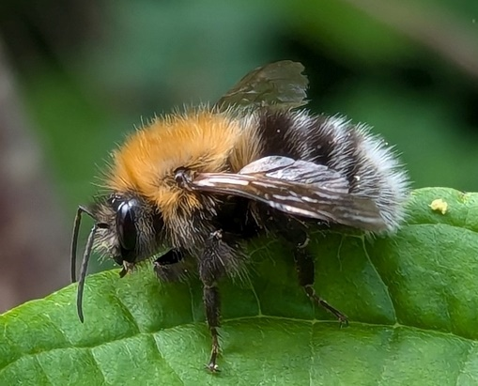
How to recognise a bumblebee outdoors
Many scientific features are hard to spot when insects are flying around outside. These other features can help you recognise bumblebees outdoors.
large, round bodies
fuzzy all over
long thin antennae
Tree bumblebee
Notes:
Large, round bodies Wasps and honeybees tend to have longer, thinner bodies.
Fuzzy all over Helps separate bumblebees from many other insects, although some flies are also fuzzy.
Long, thin antennae Separates from hoverflies, which usually have very short antennae.

Slide 8
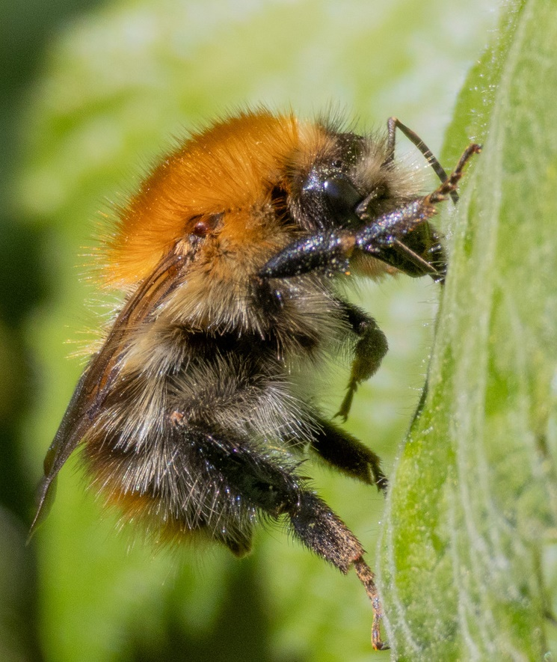
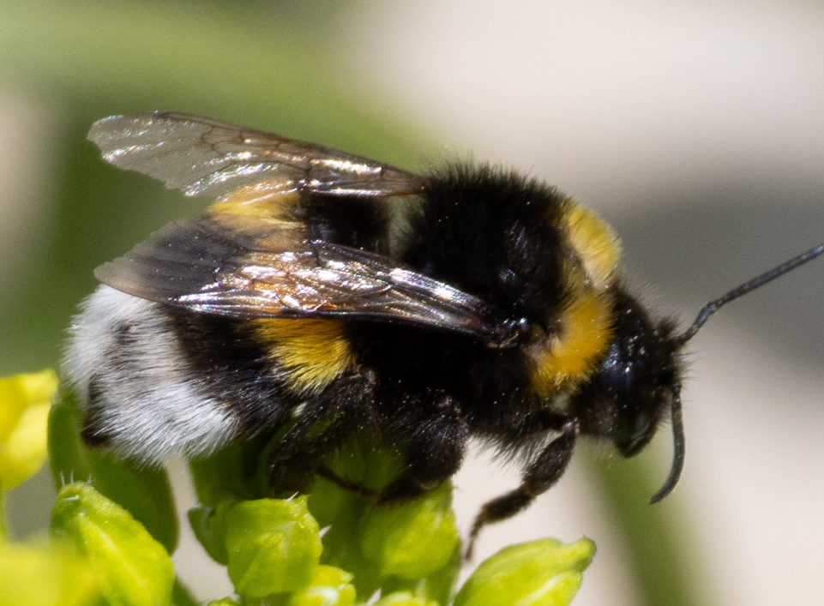
Common colour patterns
Black with yellow, white or orange bands |  | Ginger-blonde all over
White-tailed bumblebee
Common carder bumblebee

Slide 9
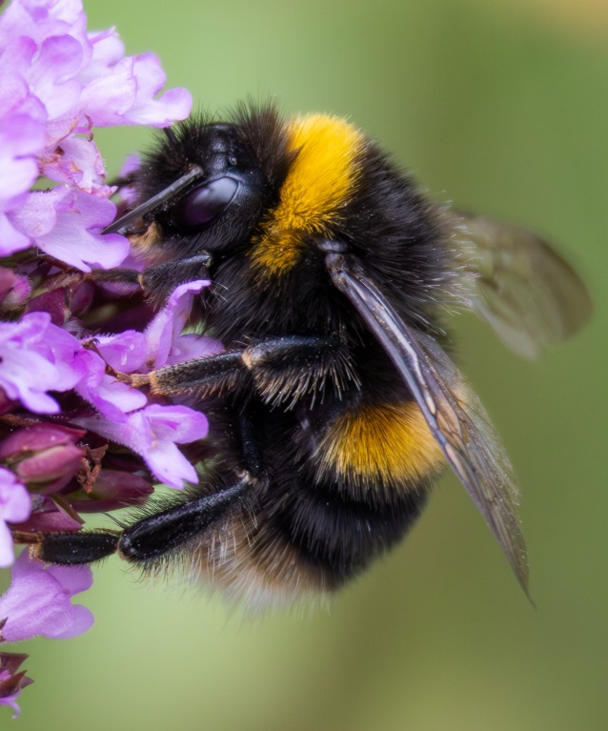
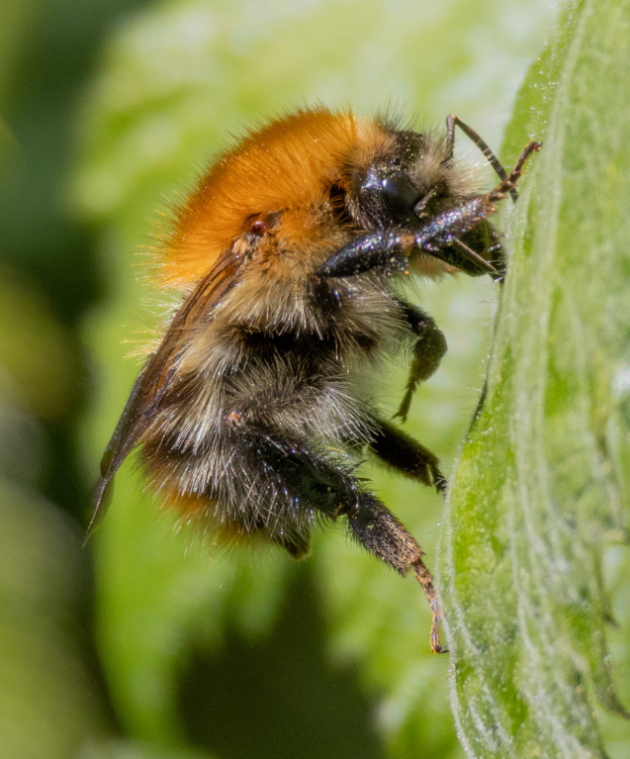
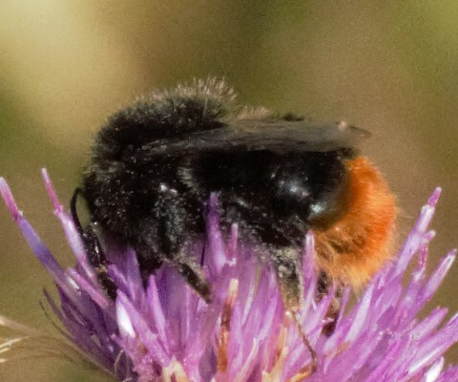
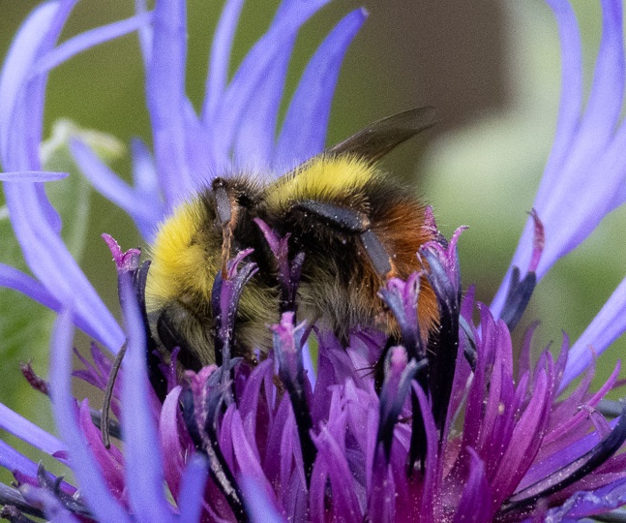
More bumblebee patterns
Buff-tailed
(worker)
Common carder (worker)
Red-tailed
(worker)
Red-tailed
(male)

Slide 10
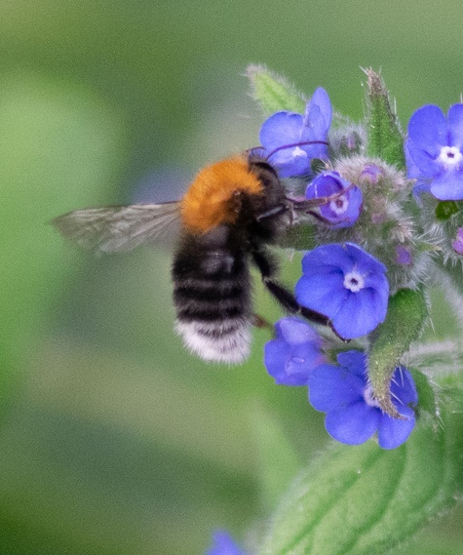
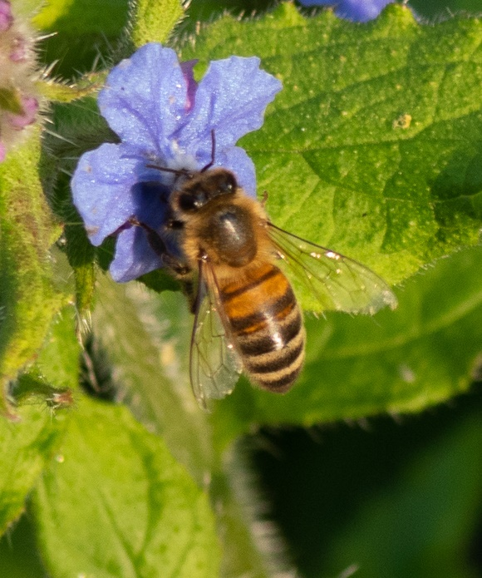
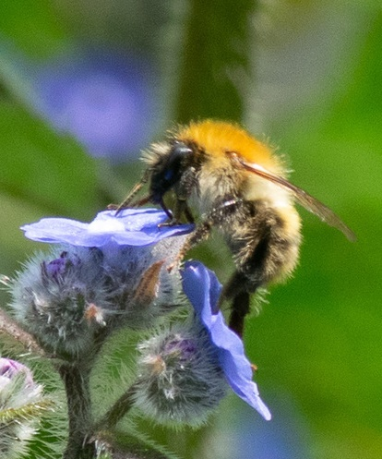
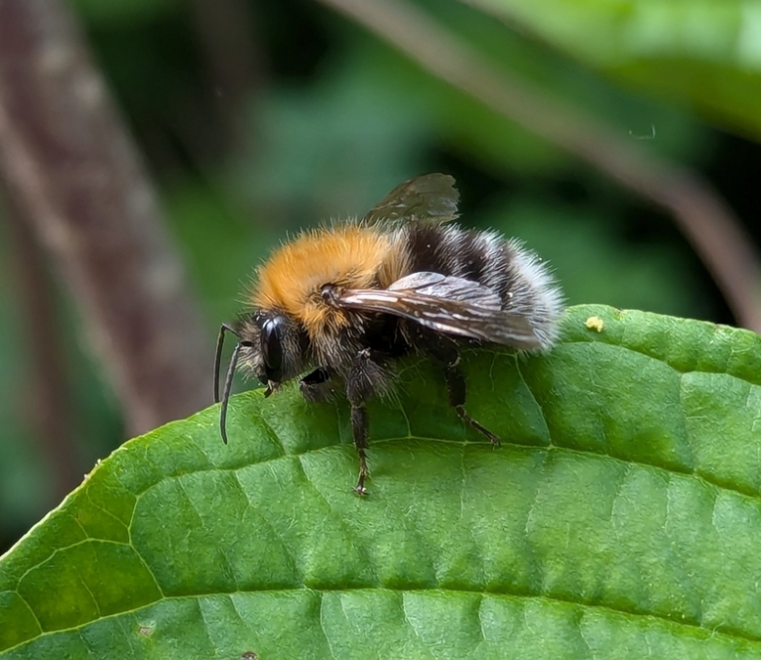

Which of these are bumblebees?
Common carder bumblebee
Tree bumblebee
Tree bumblebee
Honeybee

Slide 11
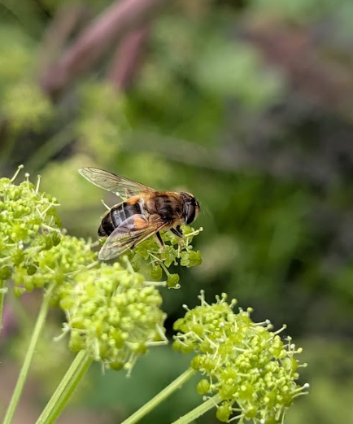
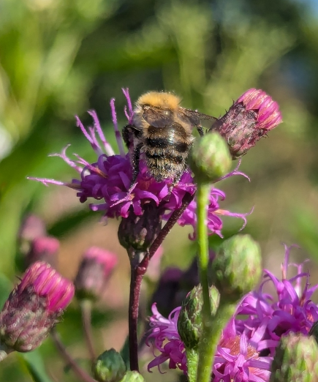
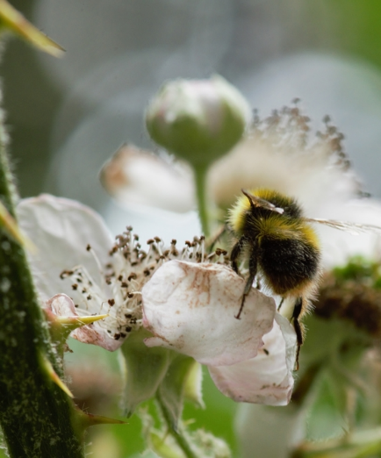
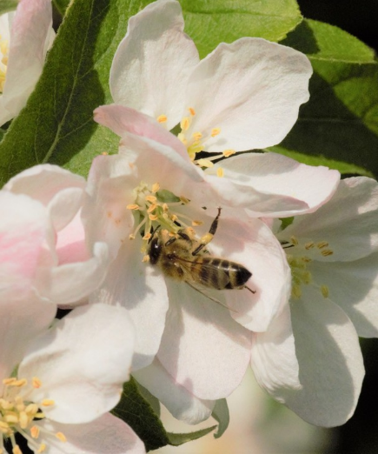
Which of these are bumblebees?
Hoverfly
Common carder bumblebee
Early bumblebee
Honeybee

Slide 12
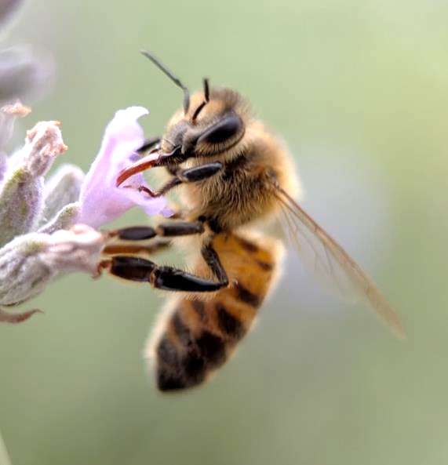
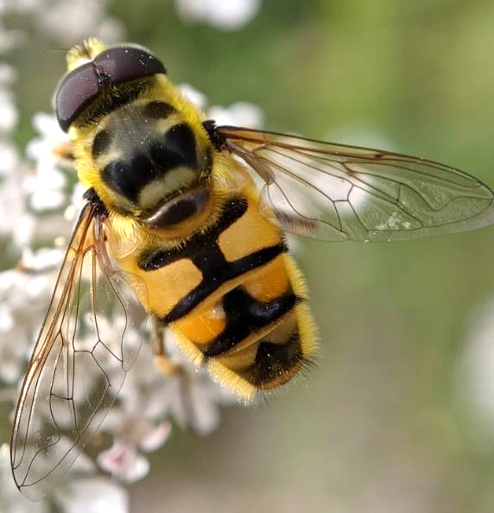
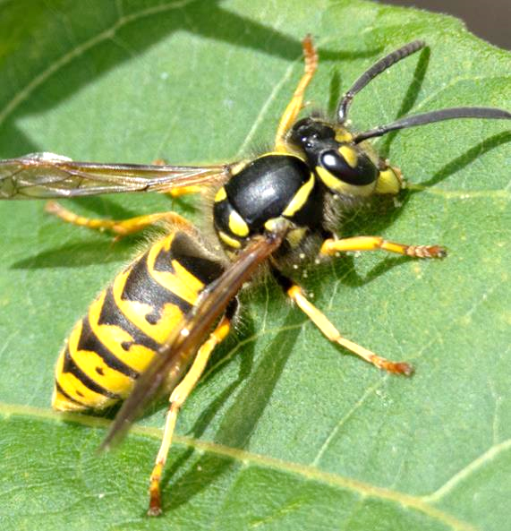
These are NOT bumblebees.
How many clues can you spot that tell us these are not bumblebees?
Honeybee
Batman hoverfly
Yellowjacket wasp
Notes:
A few potential answers:
Their bodies are not very rounded
Their bodies are not very furry.
The mouth parts on the wasp look different. (The wasp has chewing mandibles, and does not have the long tongue)
The hoverfly doesn’t look like it has antennae. (It has very small, short antennae)
The hoverfly only has one pair of wings. (Honeybees and wasps do have two pairs of wings like bumblebees, though they are difficult to spot.)
If you have learned about bumblebees as pollinators, learners might notice that the wasp does not have a pollen basket on its back legs.

Slide 13
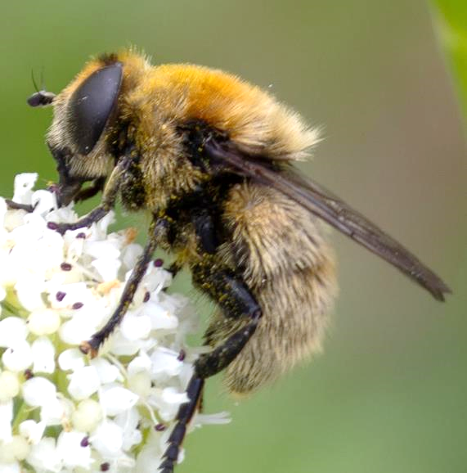
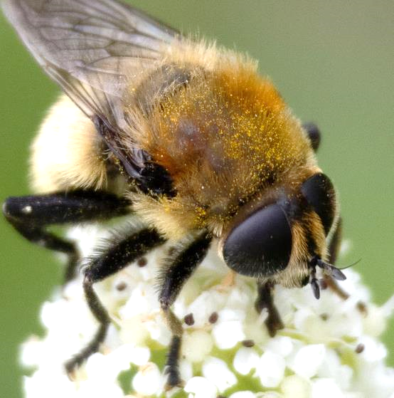
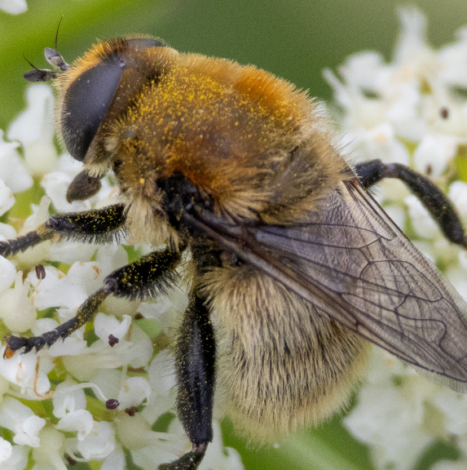
Challenge!
Here are 3 photos of the same animal. It is NOT a bumblebee.
How many clues can you spot that tell us that this is not a bumblebee?
Notes:
A few potential answers
Antennae are short nubs. (This shape of antennae is only seen in flies. All bees and bumblebees have long, thin antennae.)
Eyes are VERY big and round, taking up most of the head. (Bees have slightly smaller eyes that are usually more oval or almond-shaped.)
Only has 1 pair of wings. (This is difficult to see. But might be spotted in the 3rd photo.)
Mouth has a round pad at the end. (Bees and bumblebees have mouth parts that are long and pointed)
This is the Narcissus bulb fly. It eats pollen and nectar from flowers as an adult. As a larva it lives underground and eats the bulbs of bluebells, daffodils, and related plants. Scientists think it has evolved to mimic (look like) bumblebees because bumblebees can sting, so looking like a bumblebee might keep potential predators away. The narcissus bulb fly cannot sting or bite.

